Slide 1






R.M.K COLLEGE OF ENGINEERING AND TECHNOLOGY
Computer science(cyber security)
ROBOT FOR DETECTING ALIVE HUMANS IN WAR FIELDS AND NATURAL DISASTER AFFECTED ZONES
Team members:
LAKSHYA .R
SK.DHARSHNI
JOTHISHA.K
Team name:
CYBERHEIST

Slide 2

ABSTRACT
The study presents an robot designed for catastrophe inspection to safeguard rescue personnel during crises like earthquakes and fires. Equipped with gas, temperature, and MEMS sensors, the robot collects real-time environmental data, aiding in better decision-making and response strategies. This system aims to enhance situational awareness and mitigate risks in hazardous scenarios.

Slide 3
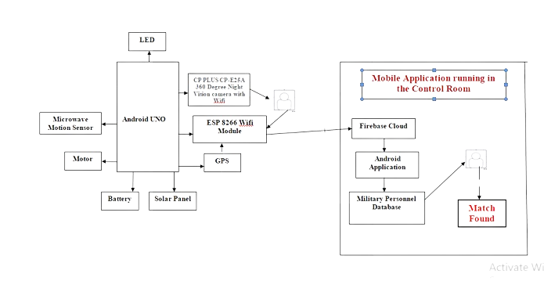
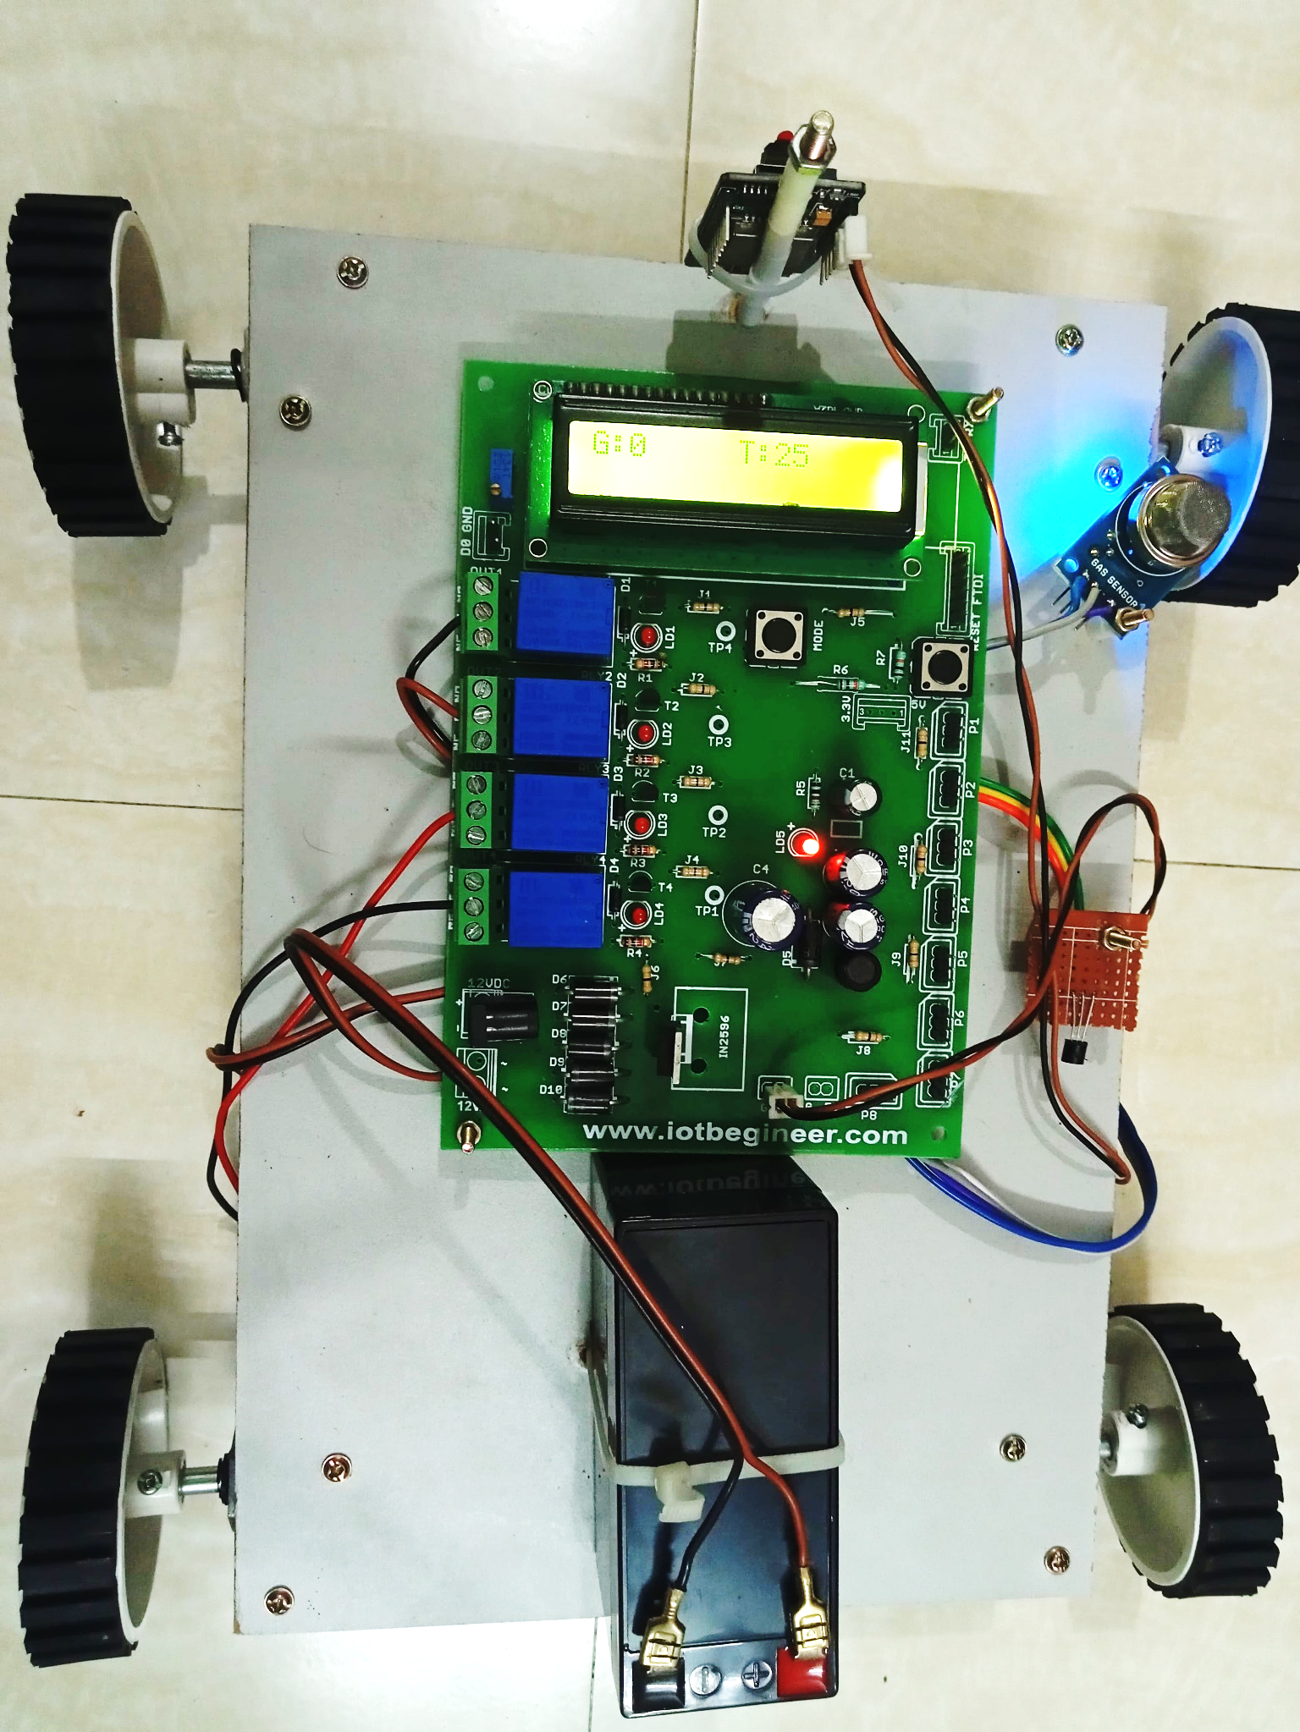
Methodology
BLOCK DIAGRAM
FIG 1.1
FIG 1.2

Slide 4

SENSOR
01
02
03
04
Gas Sensor quickly detects gas leaks with high sensitivity, providing analog voltage readings. It can detect gases like iso-butane, propane, LNG, and cigarette smoke, and includes a carbon monoxide sensor for industrial applications.
The LM35 is an IC sensor for precise temperature measurement in degrees Celsius, offering higher accuracy than thermistors. It has sealed circuitry to prevent oxidation, produces a higher output voltage than thermocouples, potentially eliminating the need for amplification.
Accelerometers measure acceleration on one, two, or three axes and are useful for sensing vibrations and orientation. They are valuable for electronic and robotic projects due to their ability to measure speed changes quickly.
Night vision cameras use image intensifier tubes and infrared illuminators to capture clear images in low-light by amplifying and capturing reflected light.

Slide 5

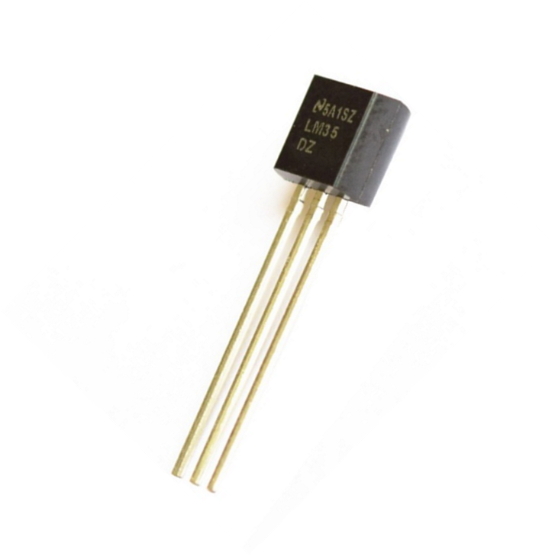
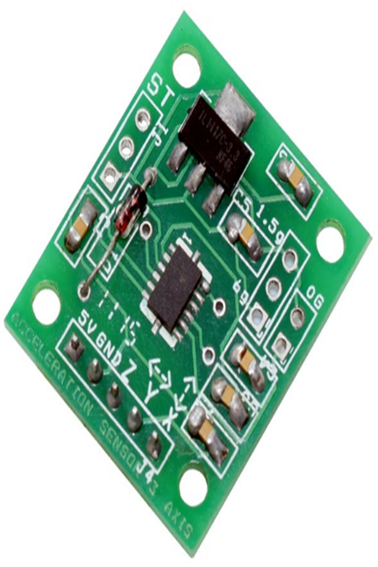
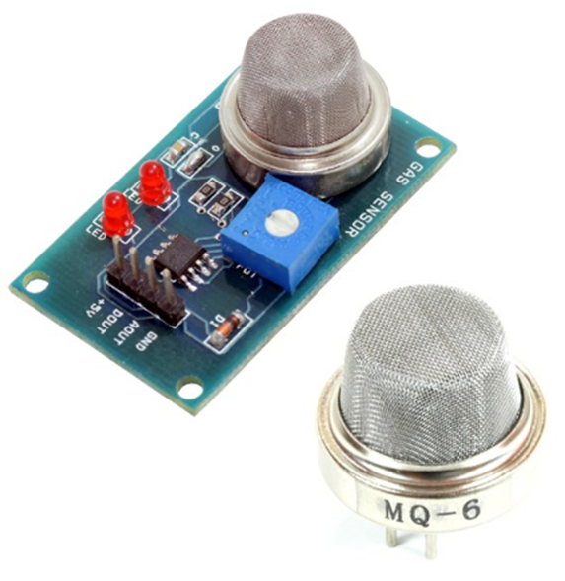
MEMS sensor
Gas sensor
Temperature sensor
FIG 1.3
FIG 1.4
FIG 1.5

Slide 6
SOFTWARE REQUIREMENTS
ARDUINO IDE
Arduino is an open-source electronics platform with user-friendly hardware and software. It can process inputs like light, touch, or messages and produce outputs like motor activation, LED illumination, or online publication.
EMBEDDED C
The design of Embedded C prioritizes language capabilities for embedded systems development, focusing on language-design principles to support efficient programming and optimization across various processors and architectures.

Slide 7
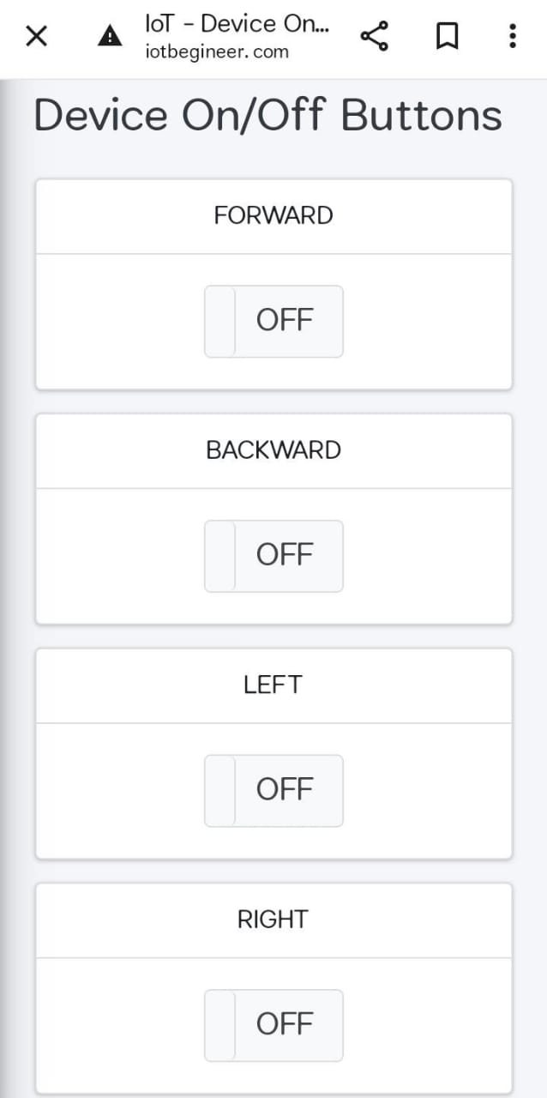
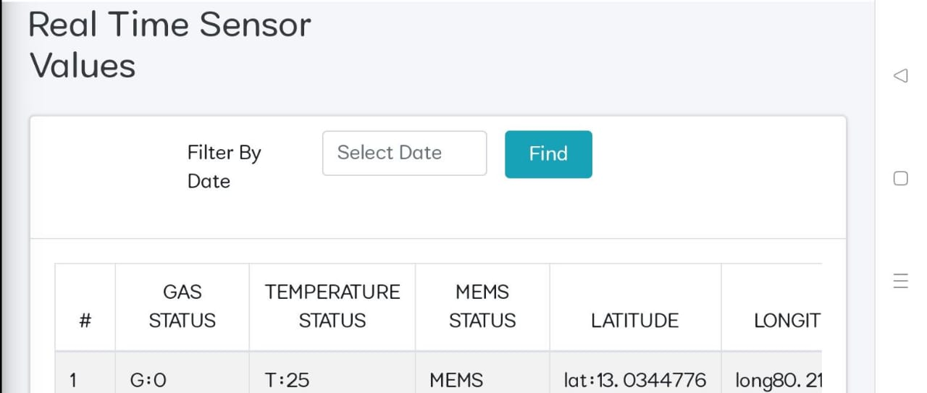
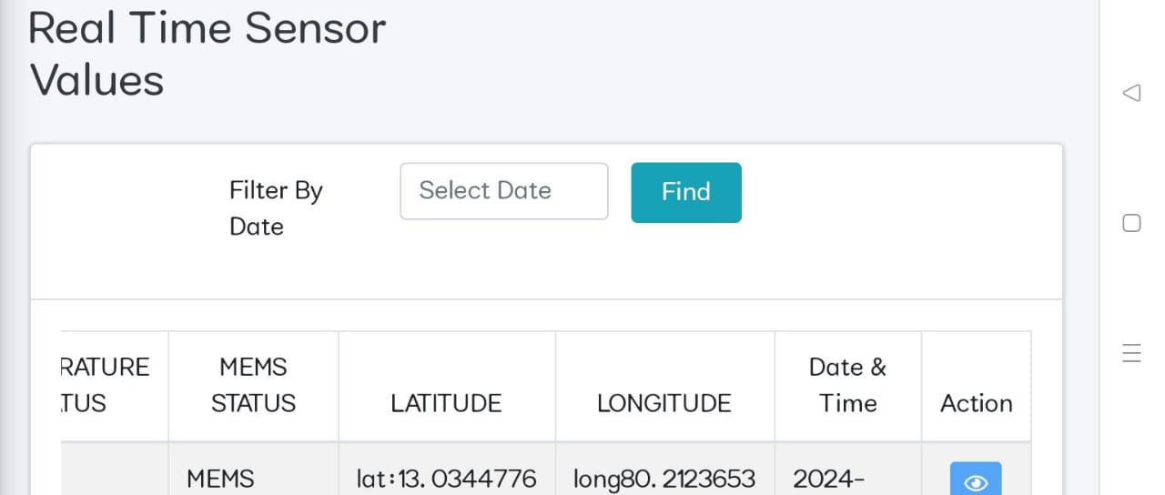
RESULTS
FIG 1.7
FIG 1.9

Slide 8
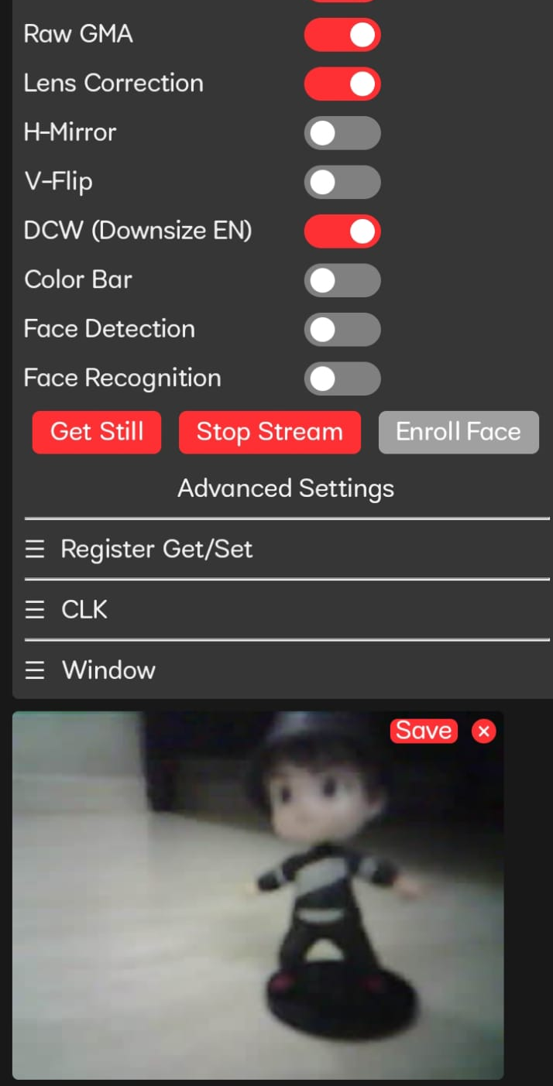
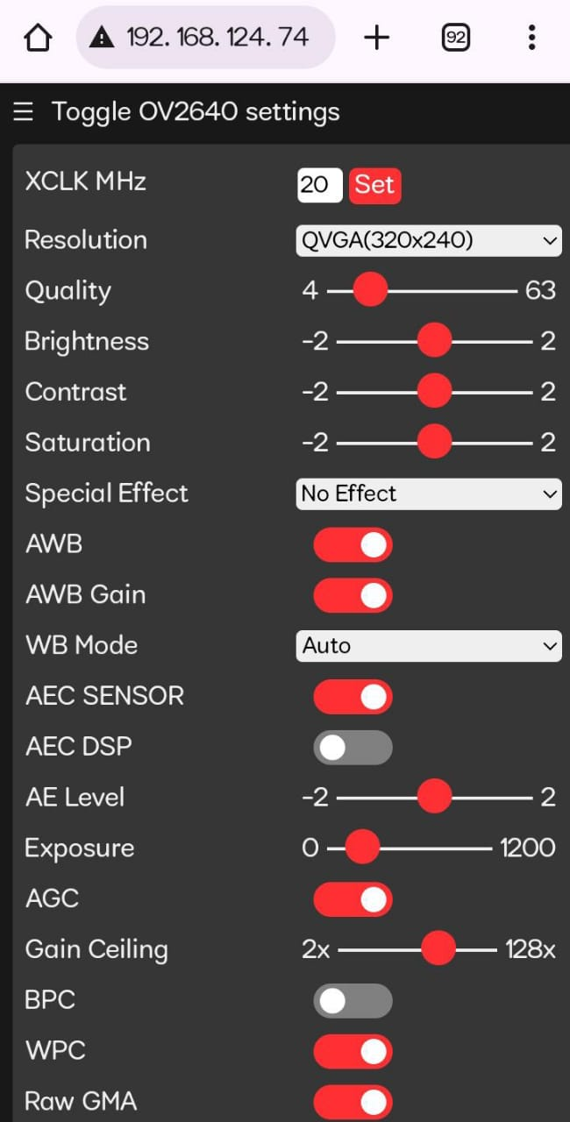
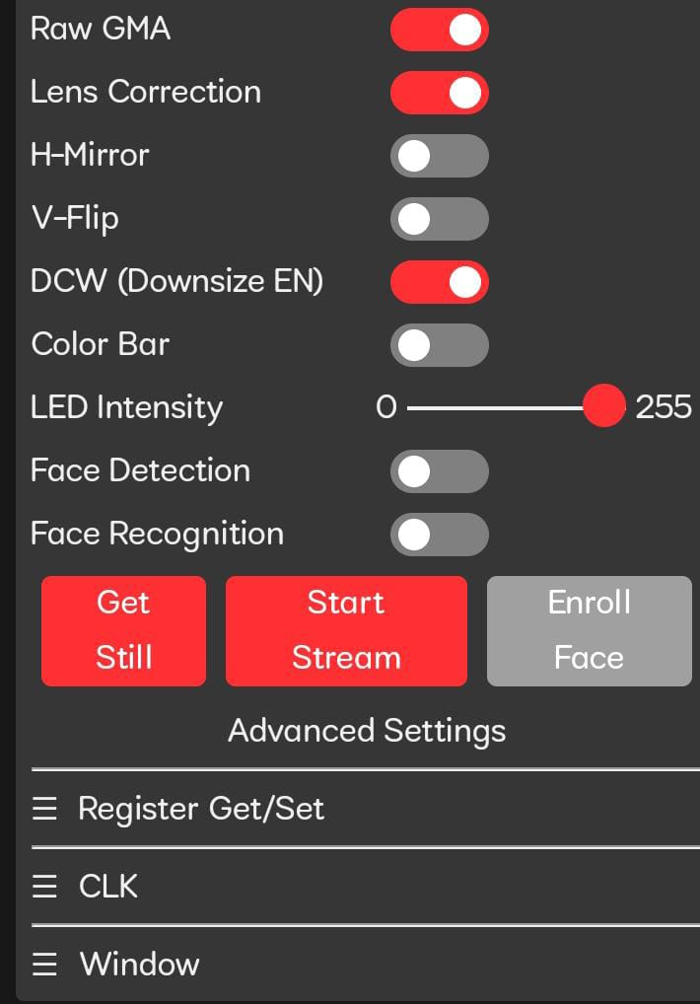
RESULTS
FIG 1.6

Slide 9
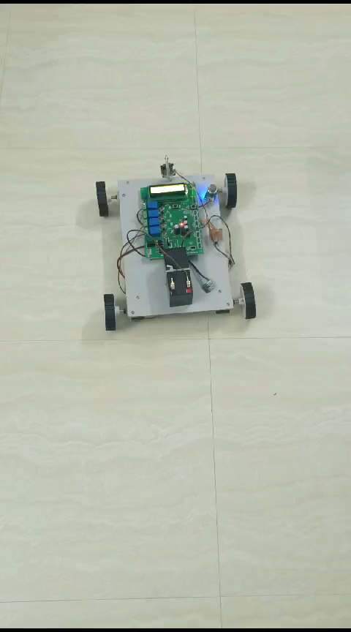
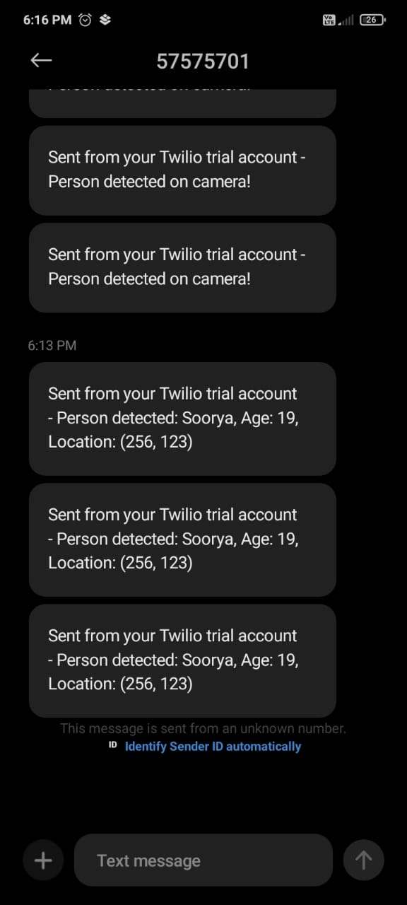
FIG 1.10

Slide 10
REFERENCES
1.Irfan Rangapur, B.K. Swathi Prasad, R. Suresh,”Design and Development of Spherical Spy Robot for Surveillance Operation”, Procedia Computer Science, Volume 171, 2020,Pages 1212-1220.
2.S.Kruthika, V.Lithika, Nivedha Parthasarathi, G.Nivedhitha,” Alive Human Detector in War Fields, Using IR Sensor and Live Video Streaming”, Journal Of Algebraic Statistics Volume 13, No. 3, 2022, p. 5118-5122.
3.K. M. Anand Vijay, S. Purustut, R. Suhas, C. Pavan and P. Pradhan, "A Live Human Being Detector in War Fields and Earthquake Location Using Robot with Camouflage Technology," 2018 3rd IEEE International Conference on Recent Trends in Electronics, Information & Communication Technology (RTEICT), Bangalore, India, 2018, pp. 2244-2249.
4.Zia Uddin, Mojaharul Islam, “Search and rescue system for alive human detection by semi-autonomous mobile rescue robot”, 2016 International Conference on Innovations in Science, Engineering and Technology (ICISET), 2016.
5.Li, K., Li, Z., Xiong, Z., Wang, Y., Yang, H., Xu, W., Jing, L., Ding, M., Zhu, J., Ho, J. S., & Chen, P.-Y. (2022). Thermal Camouflaging MXene Robotic Skin with Bio-Inspired Stimulus Sensation and Wireless Communication, Advanced Functional Materials, Vol.32,Issue.23, 2110534.

Slide 11



CONCLUSION
The development of an IoT-based robot for disaster area inspection integrates sensors to provide real-time environmental data, aiding rescue teams in decision-making. Benefits include reduced risk to responders, automated data collection, faster response times, enhanced coordination among teams, and improved communication. The system revolutionizes rescue operations, improving preparedness and response to disasters for a safer future.

Slide 12

THANK YOU!
Q/A?

